Slide 1
Graph Theory
Prof.Chandra Sekhar Akkapeddi

Slide 2
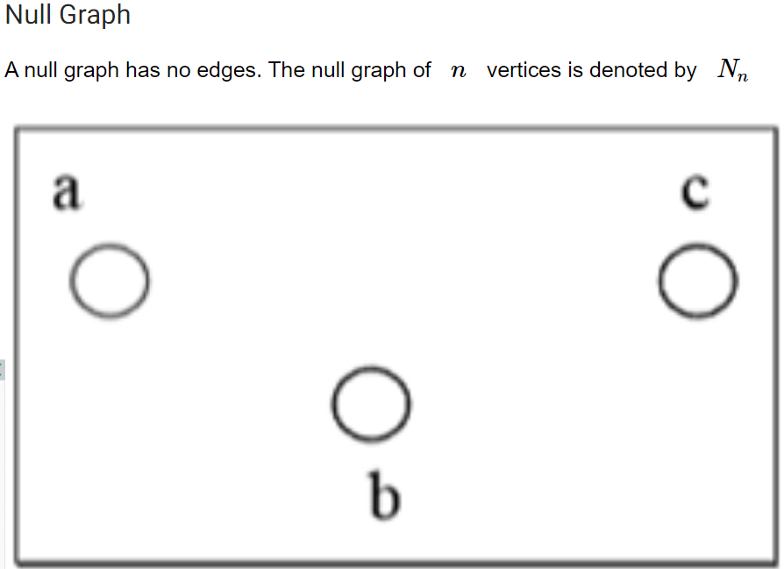
Types of Graphs

Slide 3
Module-1
Unit-1: Basics of graphs (5 hrs)
Finite and Infinite Graphs, Incidence and Degree, Isolated Vertex, Pendant Vertex, and Null Graph, complete graph, Bi-partite and complete Bi-partite graphs.

Slide 4
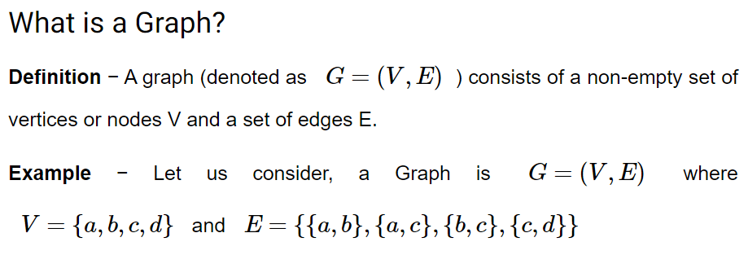
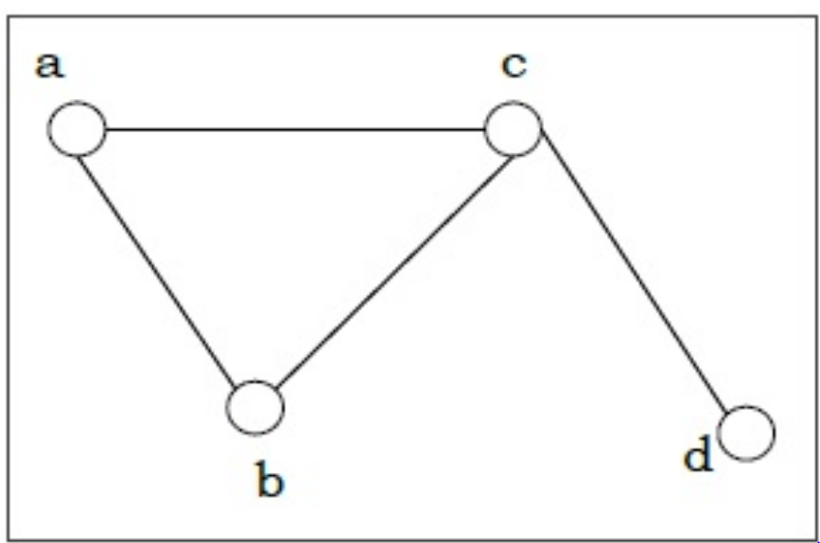
What is a Graph

Slide 5
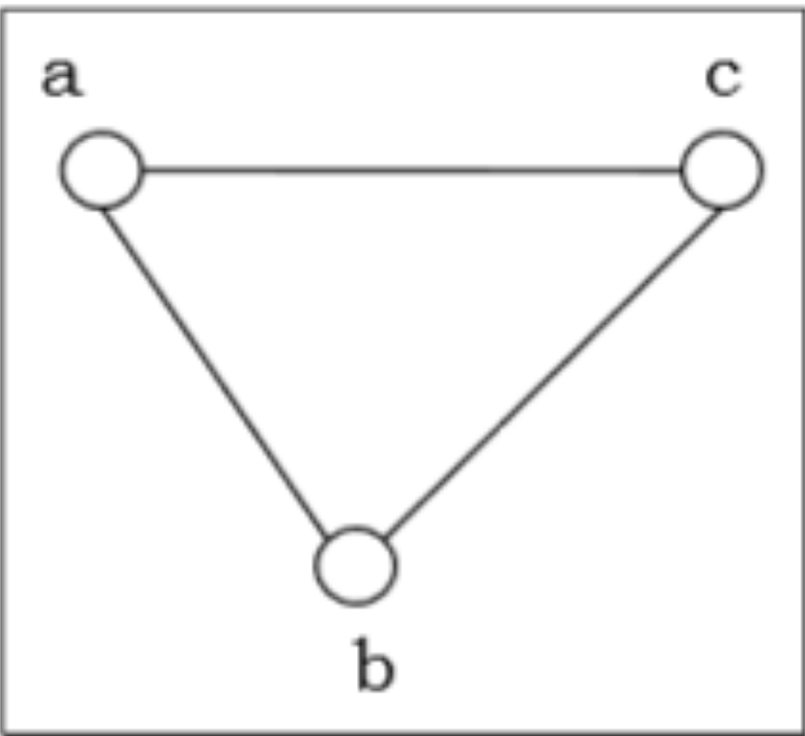
Simple Graph A graph is called simple graph/strict graph if the graph is undirected and does not contain any loops or multiple edges.

Slide 6
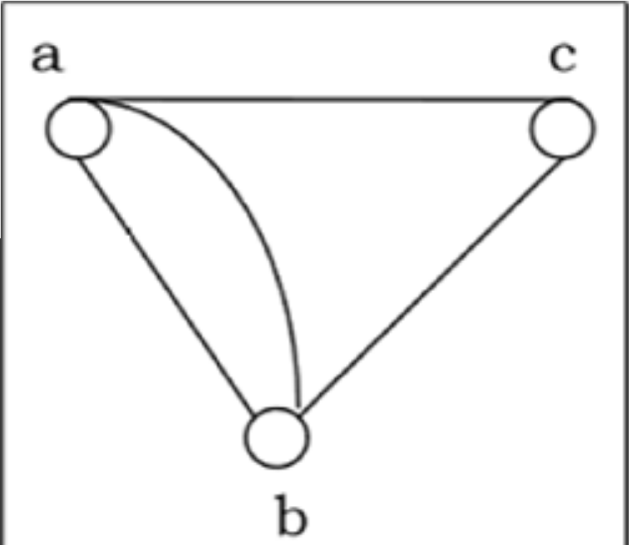
Multi-Graph If in a graph multiple edges between the same set of vertices are allowed, it is called Multigraph. In other words, it is a graph having at least one loop or multiple edges.

Slide 7
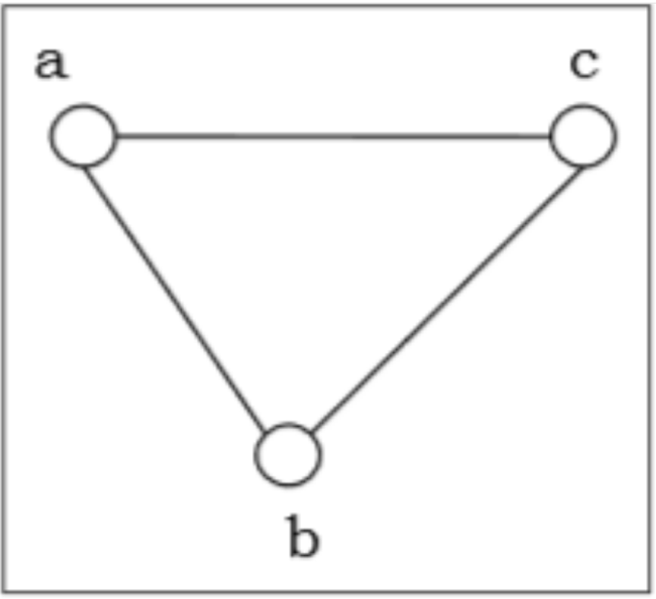
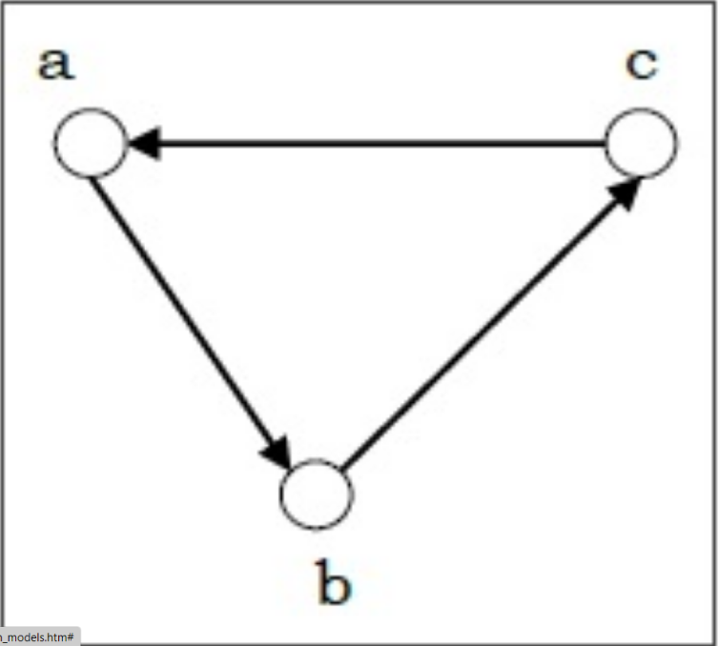
Directed and Undirected Graph A graph G=(V,E) is called a directed graph if the edge set is made of ordered vertex pair and a graph is called undirected if the edge set is made of unordered vertex pair.
Undirected
Directed

Slide 8

Complete Graph A graph is called complete graph if every two vertices pair are joined by exactly one edge. The complete graph with n vertices is denoted by Kn
The number of edges in Kn is n(n−1)/ 2 .

Slide 9
Finite and infinite graphs
A finite graph is a graph G = (V, E) such that V and E are finite sets. An infinite graph is one with an infinite set of vertices or edges or both.
Most commonly in graph theory it is implied that the graphs discussed are finite. If the graphs are infinite, that is usually specifically stated.

Slide 10
Incidence and degree
In graph theory, the degree (or valency) of a vertex of a graph is the number of edges incident to the vertex, with loops counted twice. The degree of a vertex v is denoted deg(v). The maximum degree of a graph G, denoted by Δ(G)
An isolated vertex is a vertex with degree zero

Slide 11
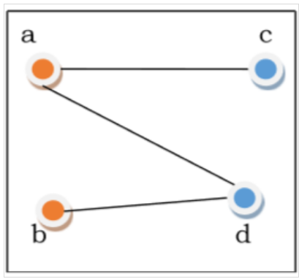
Bipartite Graph - If the vertex-set of a graph G can be split into two disjoint sets, V₁ and V₂ , in such a way that each edge in the graph joins a vertex in V₁ to a vertex in V₂ , and there are no edges in G that connect two vertices in V₁ or two vertices in V₂ , then the graph G is called a bipartite graph.
Bipartite graphs are extensively used in modern coding theory, especially to decode code words received from the channel

Slide 12
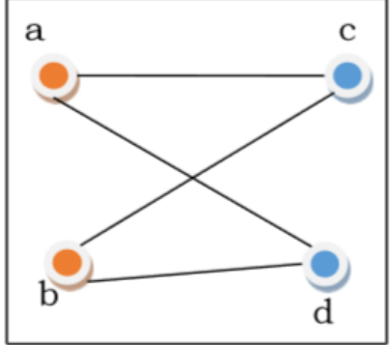
Complete Bipartite Graph - A complete bipartite graph is a bipartite graph in which each vertex in the first set is joined to every single vertex in the second set. The complete bipartite graph is denoted by K_{x,y} where the graph G contains x vertices in the first set and y vertices in the second set.

Slide 13
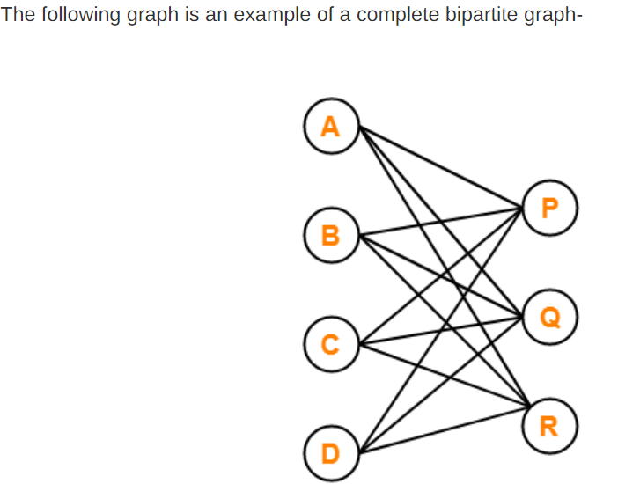
Examples

Slide 14
Theorems
Hand shaking lemma.jpg

Slide 15
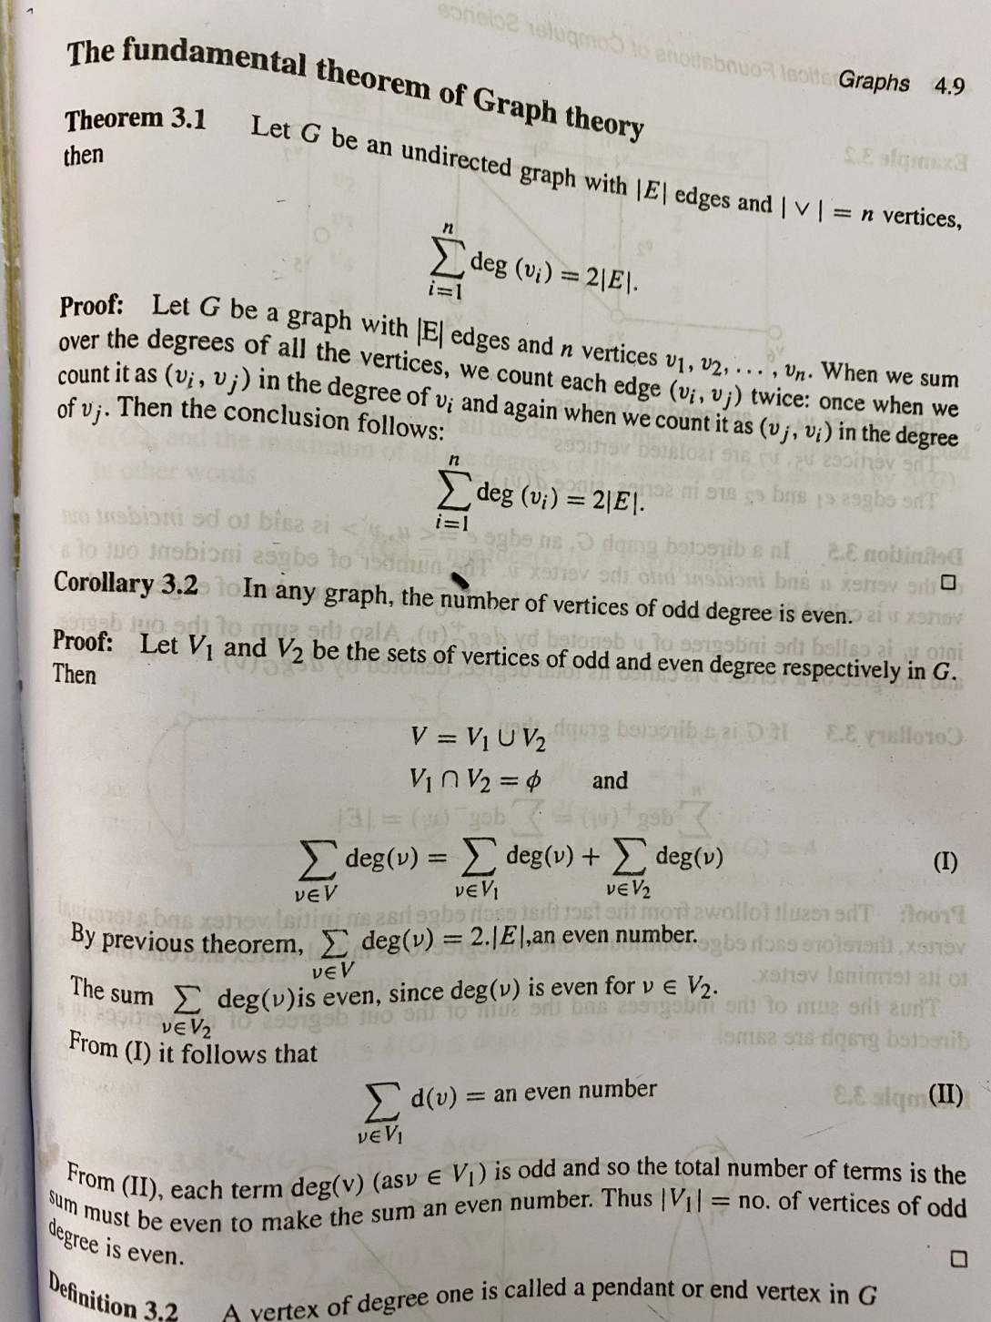

Slide 16
UNIT-II
Matrix representation of graphs: (5hrs)
Adjacency Matrix
Incidence Matrix
Path Matrix(Definition and examples)

Slide 17
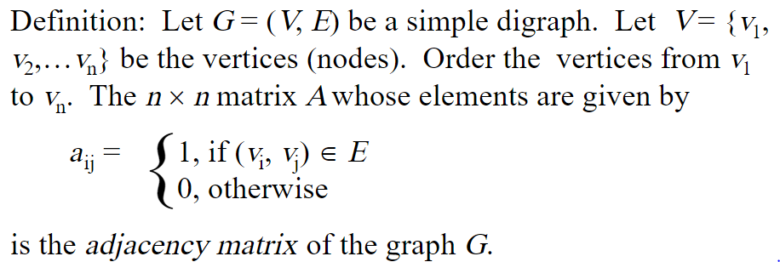
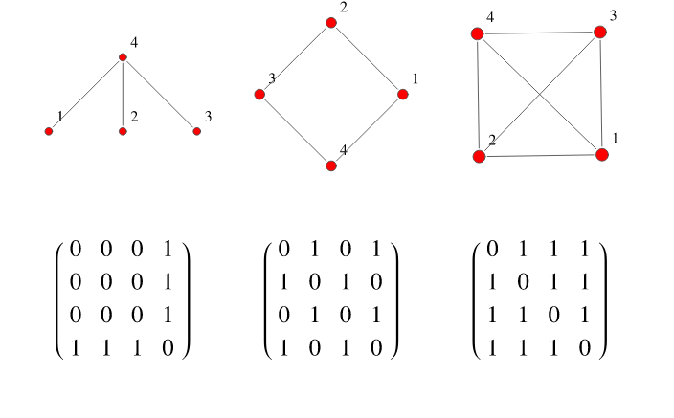
Adjacency Matrix

Slide 18
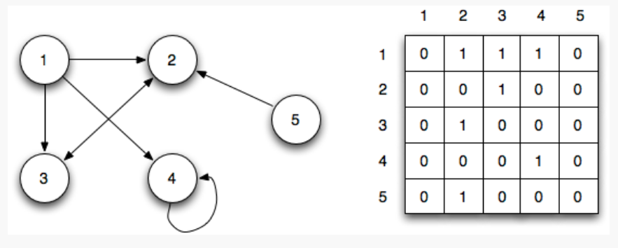
Adjacency Matrix

Slide 19
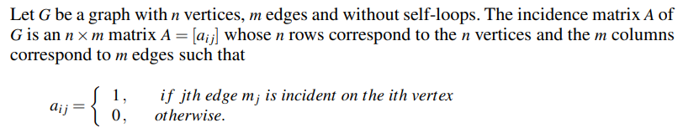
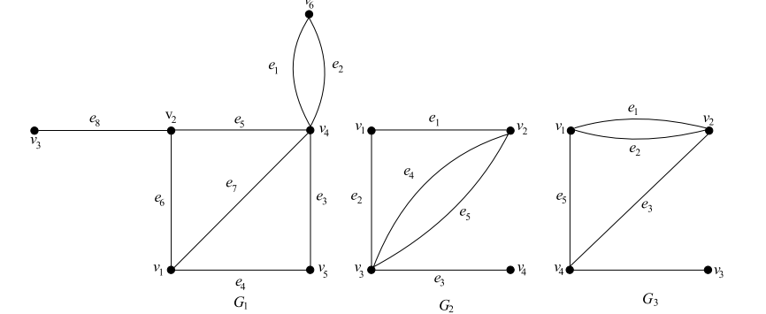
Incidence Matrix

Slide 20
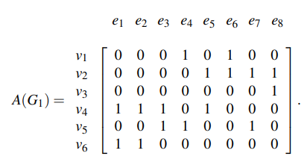
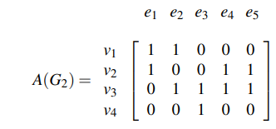
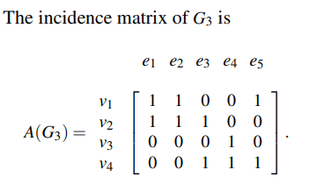
Incidence Matrix-Example

Slide 21
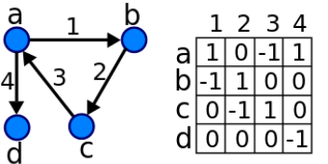
Incidence matrix of a digraph

Slide 22
Path Matrix
Let G = ( V, E ) be a simple digraph having no parallel edges . An n x n matrix P = [Pij] given by P_{i j} = { 1 if there is a path from v_{i} to v_{j}
{ o otherwise
Is called the Path matrix( or Reachability Matrix

Slide 23
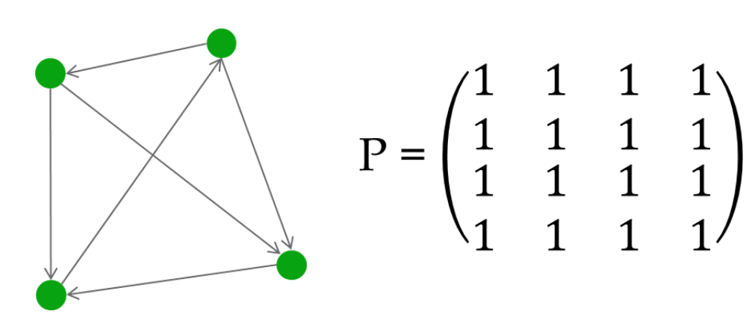
Path Matrix-Examples

Slide 24
Unit-III
Paths and circuits (6 hours)
1.Paths and Circuits
2. Connected Graphs
3. Disconnected Graphs and Components
4.Euler Graphs,Hamiltonian graphs(Definition,examples and without proofs)

Slide 25
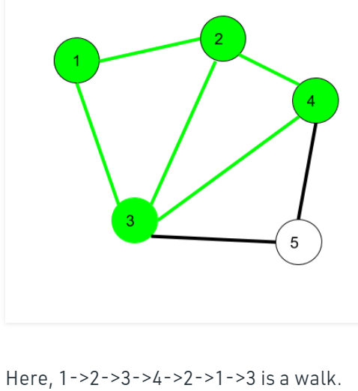
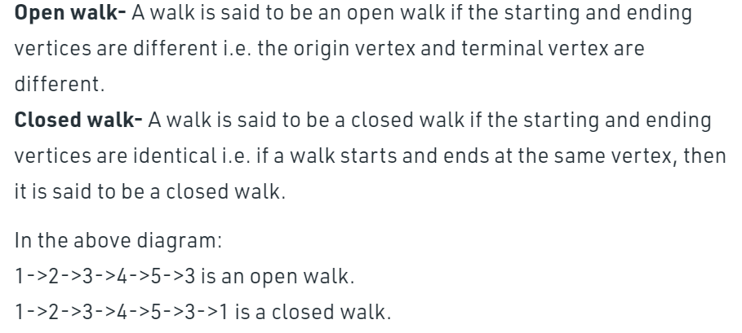
Paths and Circuits
Walk – A walk is a sequence of vertices and edges of a graph i.e. if we traverse a graph then we get a walk. Note: Vertices and Edges can be repeated.

Slide 26
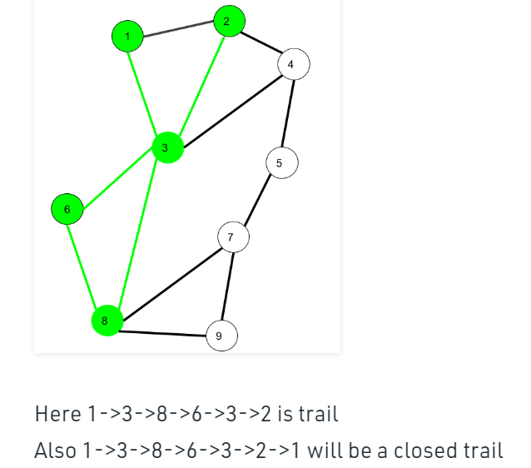
Trail – Trail is an open walk in which no edge is repeated. Vertex can be repeated.

Slide 27
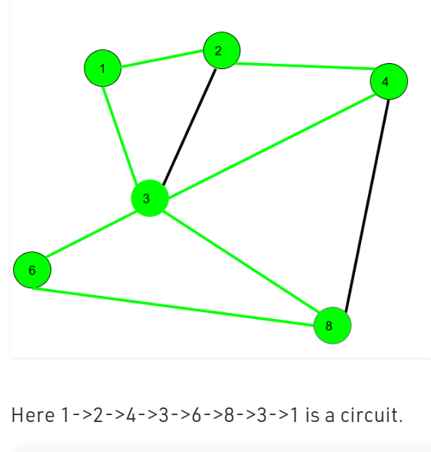
Circuit
Circuit – Traversing a graph such that not an edge is repeated but vertex can be repeated and it is closed also i.e. it is a closed trail. Vertex can be repeated. Edge can not be repeated.
Circuit is a closed trail. These can have repeated vertices only.

Slide 28
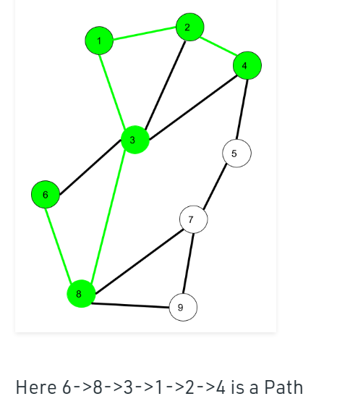
Path
Path – It is a trail in which neither vertices nor edges are repeated i.e. if we traverse a graph such that we do not repeat a vertex and nor we repeat an edge. As path is also a trail, thus it is also an open walk.
Vertex not repeated Edge not repeated

Slide 29
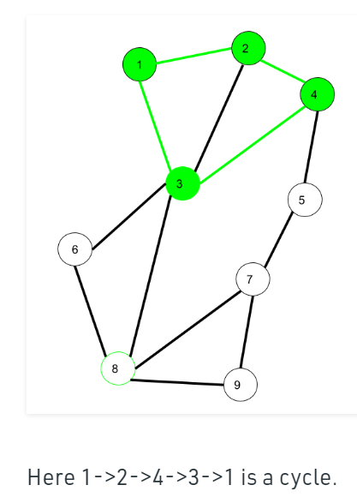
Cycle
Traversing a graph such that we do not repeat a vertex nor we repeat a edge but the starting and ending vertex must be same i.e. we can repeat starting and ending vertex only then we get a cycle.
Vertex not repeated Edge not repeated

Slide 30
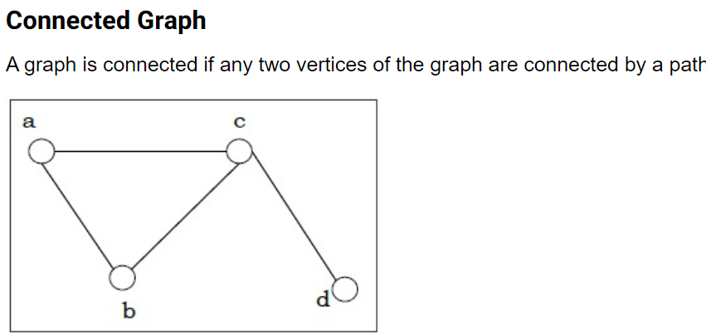
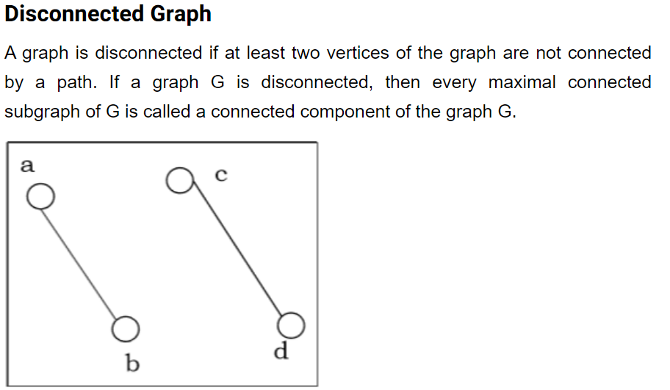
Connected, Disconnected and Components

Slide 31
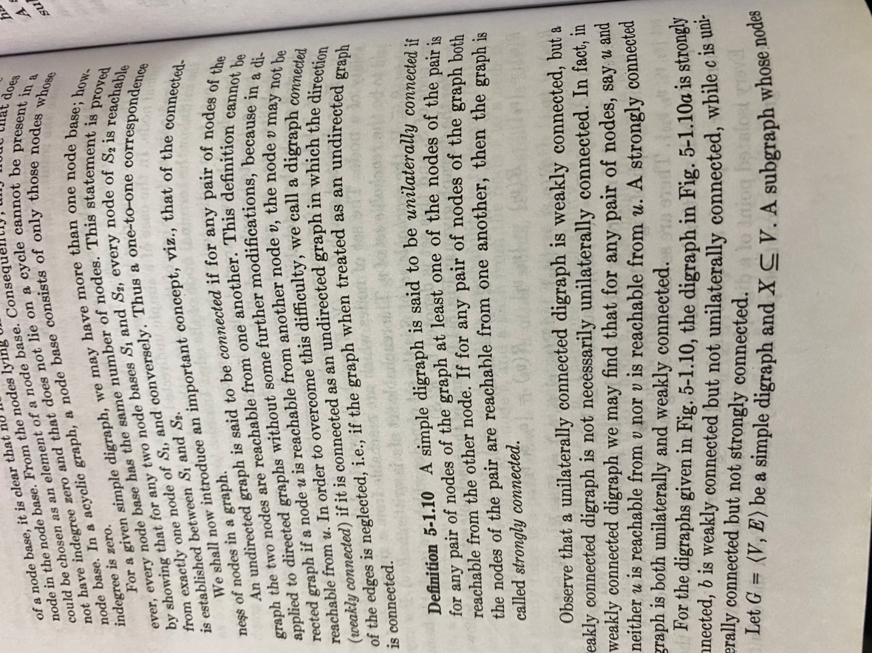
Component

Slide 32
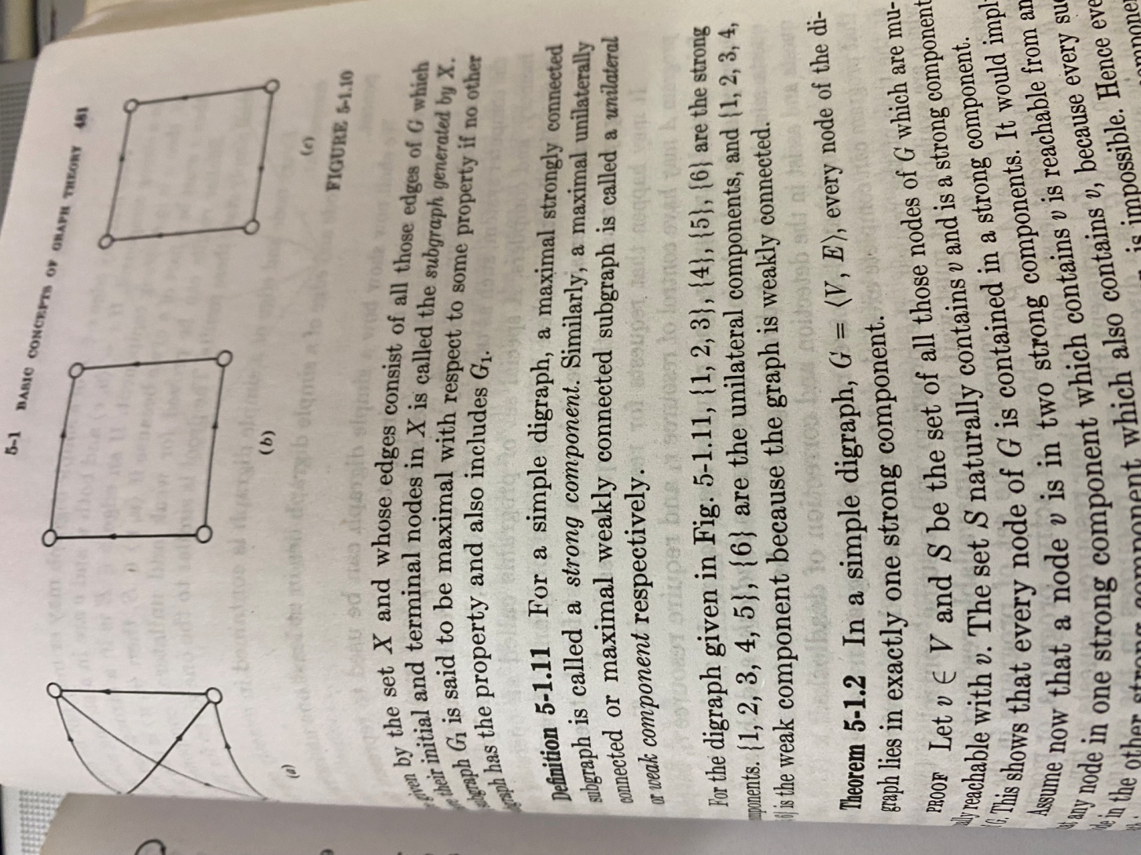

Slide 33
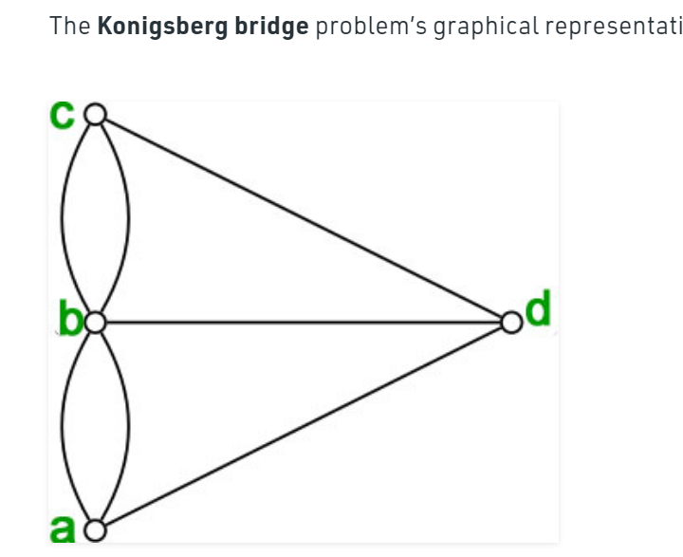
Eulerian and Hamiltonian Graphs
Euler paths and circuits :
An Euler path is a path that uses every edge of a graph exactly once.
An Euler circuit is a circuit that uses every edge of a graph exactly once.
An Euler path starts and ends at different vertices.
An Euler circuit starts and ends at the same vertex.

Slide 34
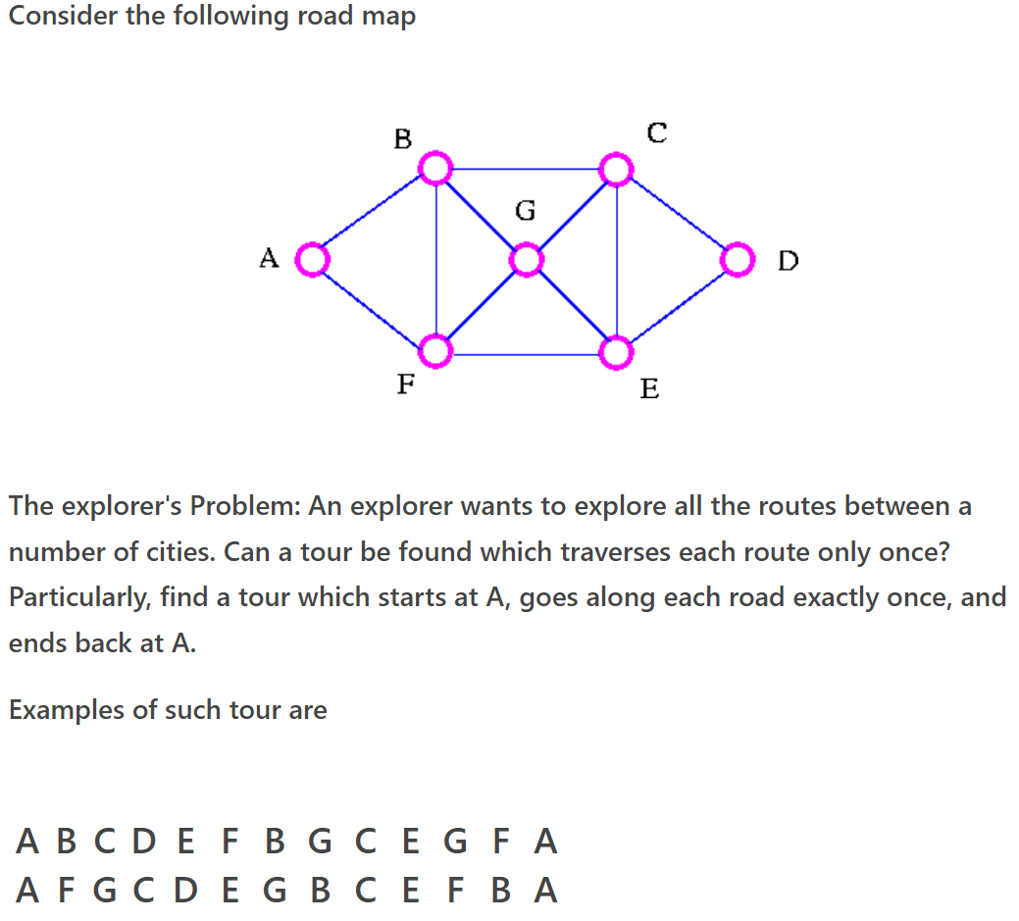
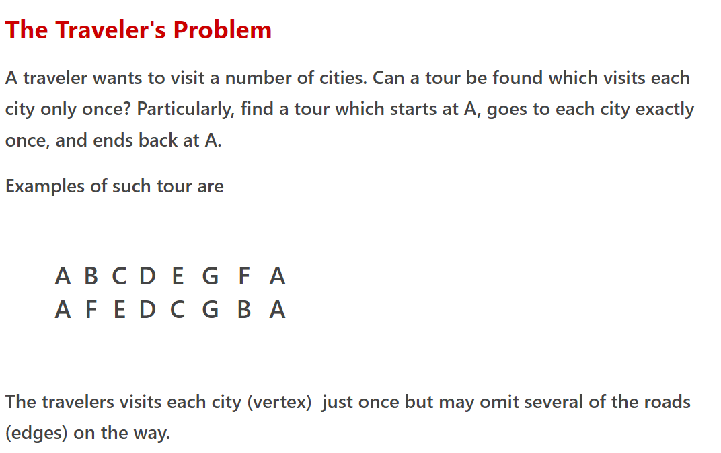
Eulerian and Hamiltonian graphs

Slide 35
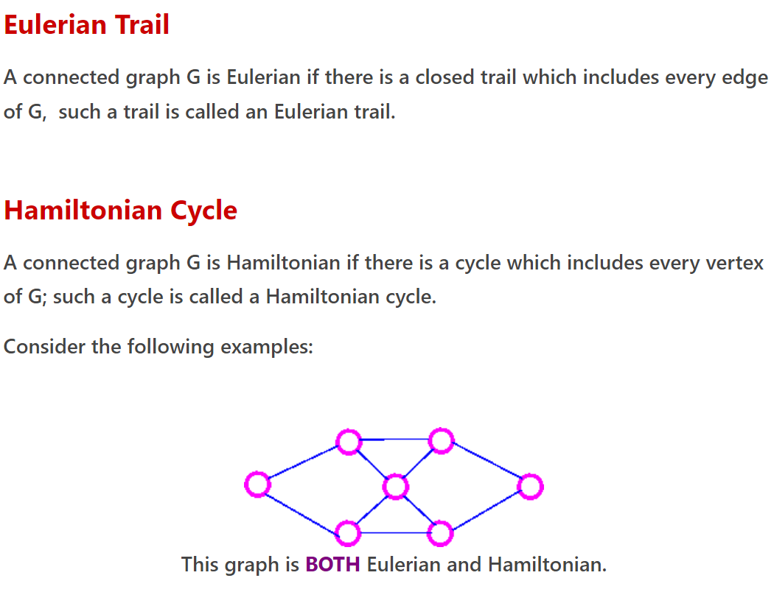

Slide 36
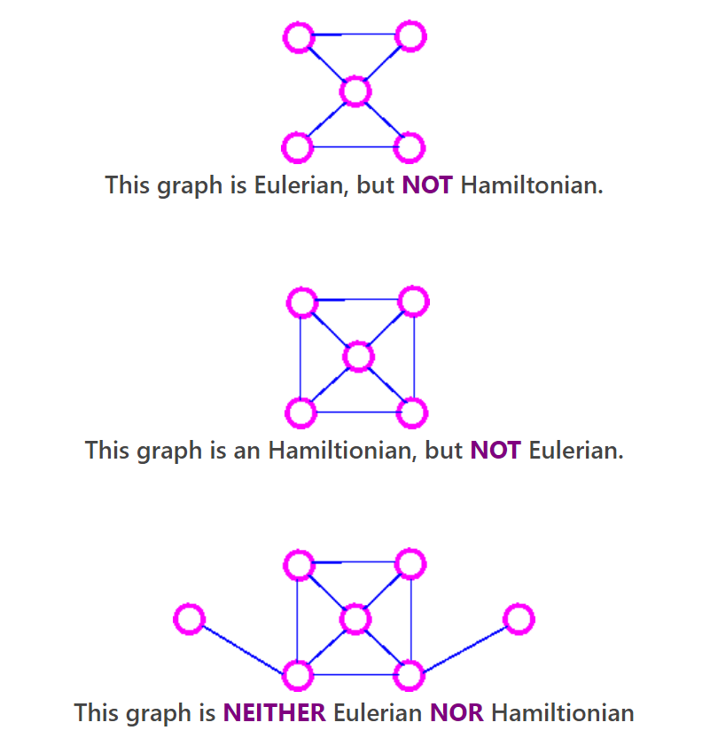
Examples

Slide 37
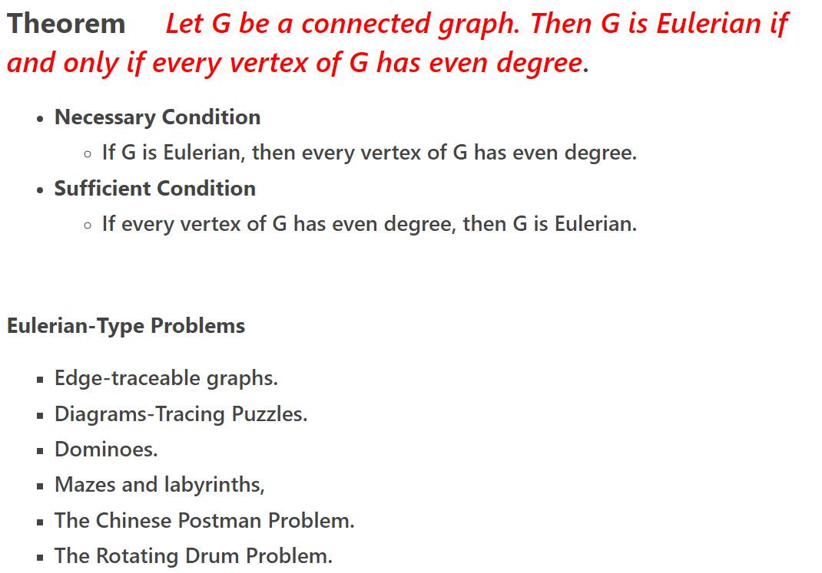
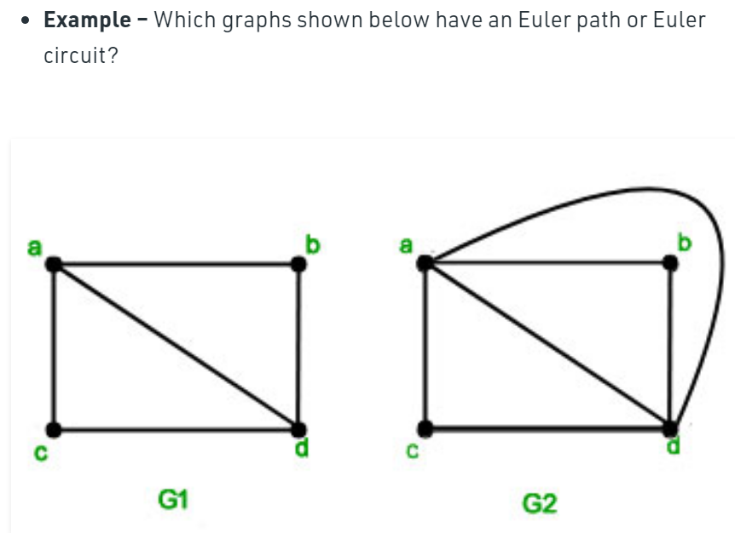
Eulerian and Hamiltonian Graphs

Slide 38
Examples

Slide 39
Hamiltonian Graphs
Hamiltonian paths and circuits :
Hamiltonian Path – A simple path in a graph that passes through every vertex exactly once is called a Hamiltonian path.
Hamiltonian Circuit – A simple circuit in a graph that passes through every vertex exactly once is called a Hamiltonian circuit.
Unlike Euler paths and circuits, there is no simple necessary and sufficient criteria to determine if there are any Hamiltonian paths or circuits in a graph..
Neither necessary nor sufficient condition is known for a graph to be Hamiltonian. The search for necessary or sufficient conditions is a major area of study in graph theory today.

Slide 40
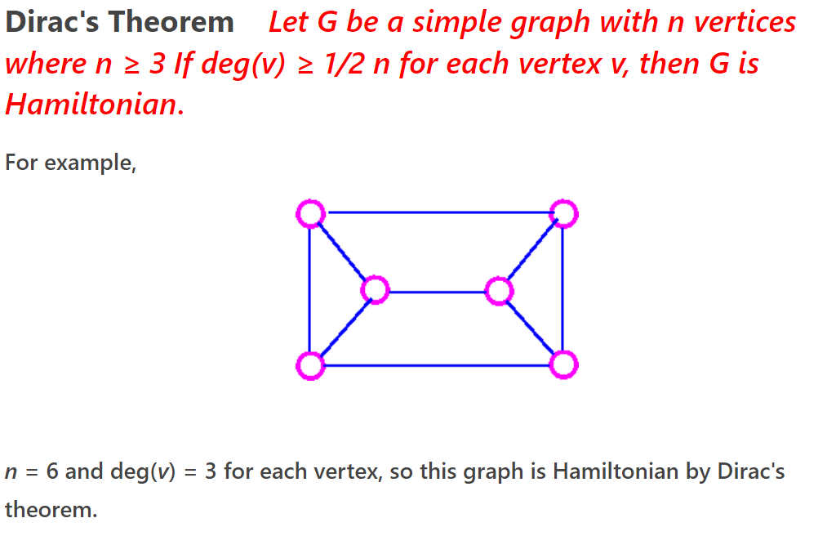
Theorem
Hamiltonain - Type Problems
Gray Codes.
The Traveling Salesperson Problem
Ranking in Tournaments.
There are (n-1)!/2 distinct Hamiltonian cycles in the complete graph of n vertices

Slide 41
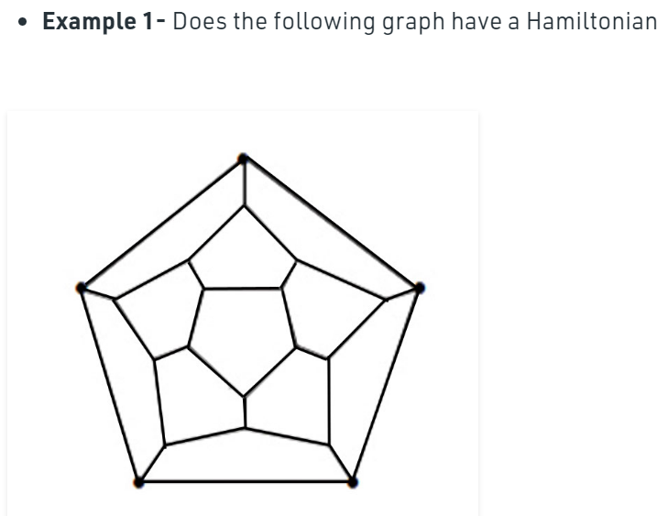
Hamiltonian Graphs

Slide 42
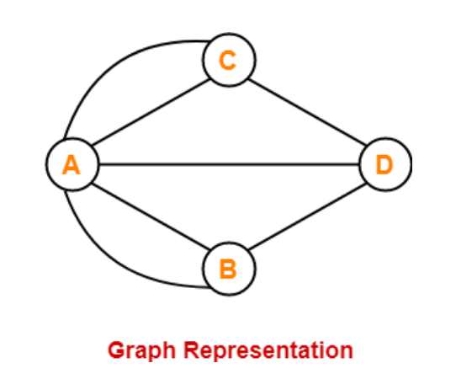
Konigsberg bridge Problem
A walking tour (Visiting all the vertices by using all edges once and only ones) is Impossible
Proof: The graph of Konigsberg bridge consists of four vertices and seven edges. Also the degree sequence of the nodes A,B,C and D are 5,3,3,3. By the Euler’s characterization a graph admits an Eulerian
Path or circuit iff the number of odd degree vertices is either 2 or 0.But there are 4 degrees of odd degree vertices in the graph.Hence the graph does not admit an Eulerian path or circuit.
Hence such a walking tour of Konigsberg bridge is impossible.

Slide 43
Unit-4- Trees-(5 hrs)
1.Trees and their properties
2.spanning trees minimal spanning trees
3. Kruskal’s algorithm for finding a minimal spanning tree,

Slide 44
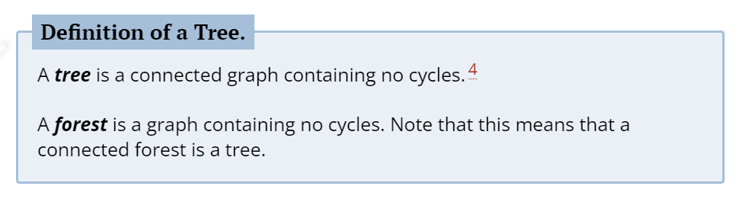
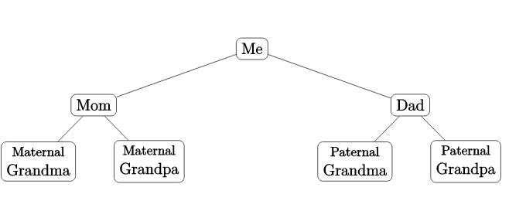
Trees

Slide 45
Properties of trees
There is only one path between each pair of vertices of a tree.
If a graph G there is one and only one path between each pair of vertices G is a tree.
A tree T with n vertices has n-1 edges.
A graph is a tree if and only if it is minimally connected.

Slide 46
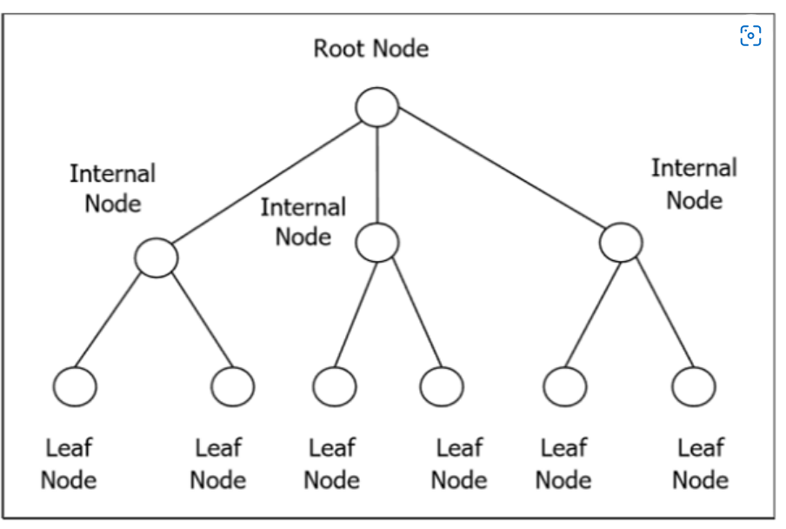
Trees
Rooted Tree
A rooted tree GG is a connected acyclic graph with a special node that is called the root of the tree and every edge directly or indirectly originates from the root.

Slide 47
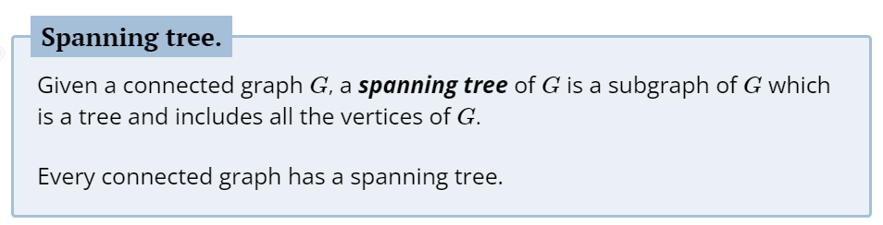
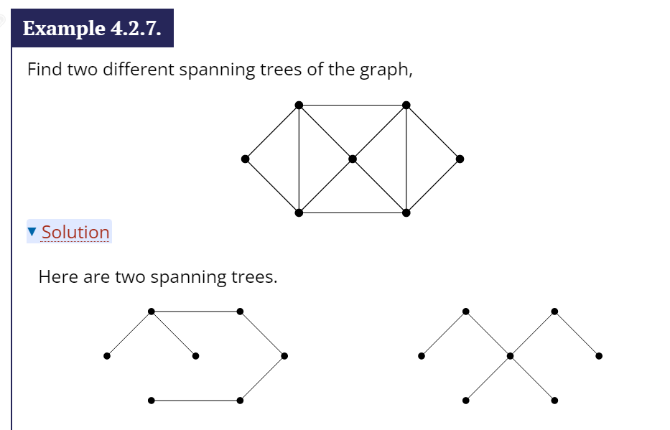
Trees

Slide 48
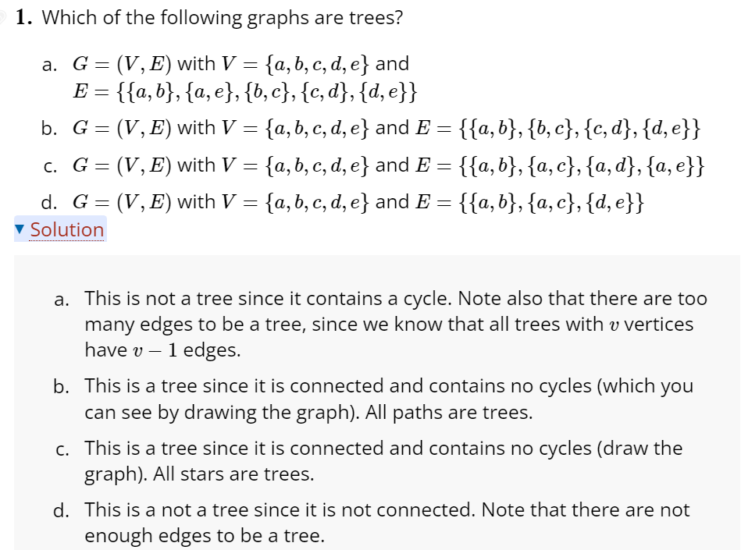
Trees

Slide 49
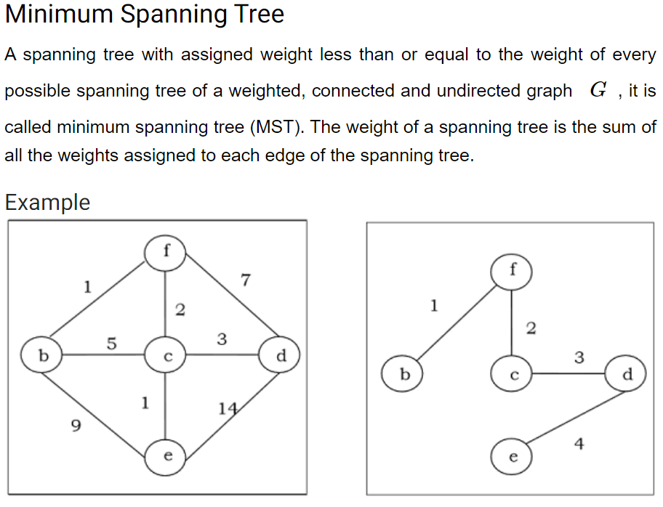
Trees

Slide 50
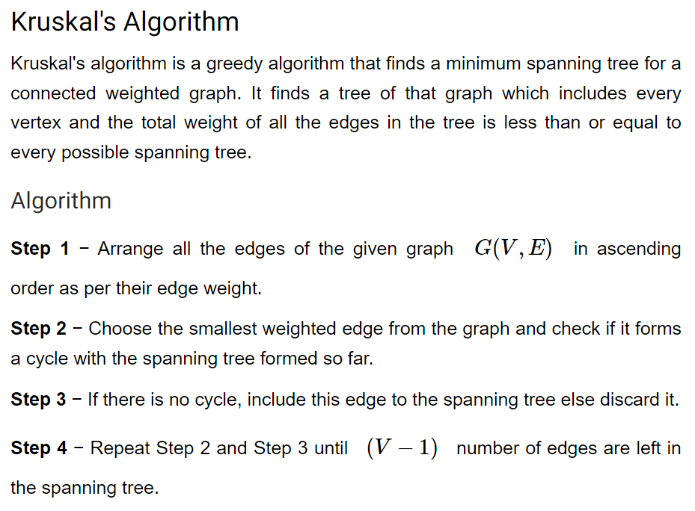
Kruskal’s Algorithm

Slide 51
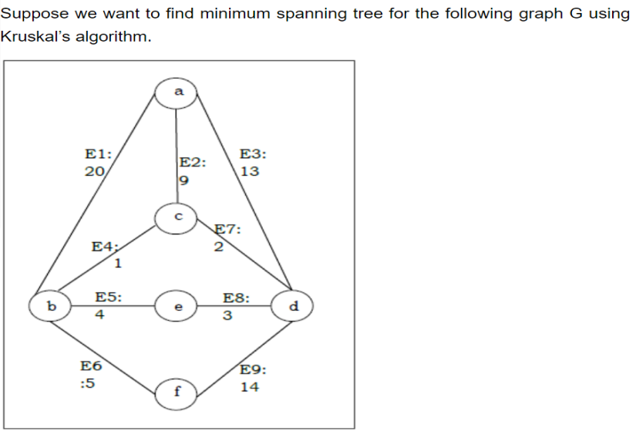





Kruskal’s Algorithm
A Complete graph with N vertices have N^{(N-2)}
^{Spanning trees}

Slide 52
Unit-5-Tree traversals-5hours
1.Preorder
2. In order and
3.post order
4. Prefix and Postfix notations of an arithmetic expression
5. parsing trees.

Slide 53
Inorder Traversal
1.In Inorder traversal we traverse from left-root-right.
2.In this traversal left subtree visited first then the root and later the right subtree.
3.remember that every node may represent a subtree itself.

Slide 54
Inorder Traversal
Algorithm
Until all nodes are traversed
Recursively Traverse the left subtree
Visit the Root.
Recursively Traverse the right subtree.

Slide 55


Inorder Traversal

Slide 56
Pre order traversal
Preorder Traversal
In Preorder traversal we traverse from root-left-right.
In this traversal root visited first then the left subtree and later the right subtree.
remember that every node may represent a subtree itself.

Slide 57

Pre order traversal
Algorithm of preorder traversal
Until all nodes are traversed
Visit the Root
Recursively Traverse the left subtree
Recursively Traverse the right subtree

Slide 58

Preorder traversal

Slide 59
Postorder traversal
Postorder Traversal
In Preorder traversal we traverse from left-right-root.
In this traversal left subtree visited first then the right subtree and later the root.
remember that every node may represent a subtree itself.
Algorithm of postorder traversal
Until all nodes are traversed
Recursively Traverse the left subtree
Recursively Traverse the right subtree.
Visit the Root.

Slide 60



Postorder traversal

